Slide 1
Analyzing the BeanOCart data
Project Leader: Viviana Medina
PI: Matthew Gilbert

Slide 2
Lab Objective
We have created a version of this cart, to answer the following question: https://www.youtube.com/watch?v=DNQPhQ0CpI0
Question: How do beans survive under drought stress?
This is a many factor problem and one in which computer analysis vital.

Slide 3
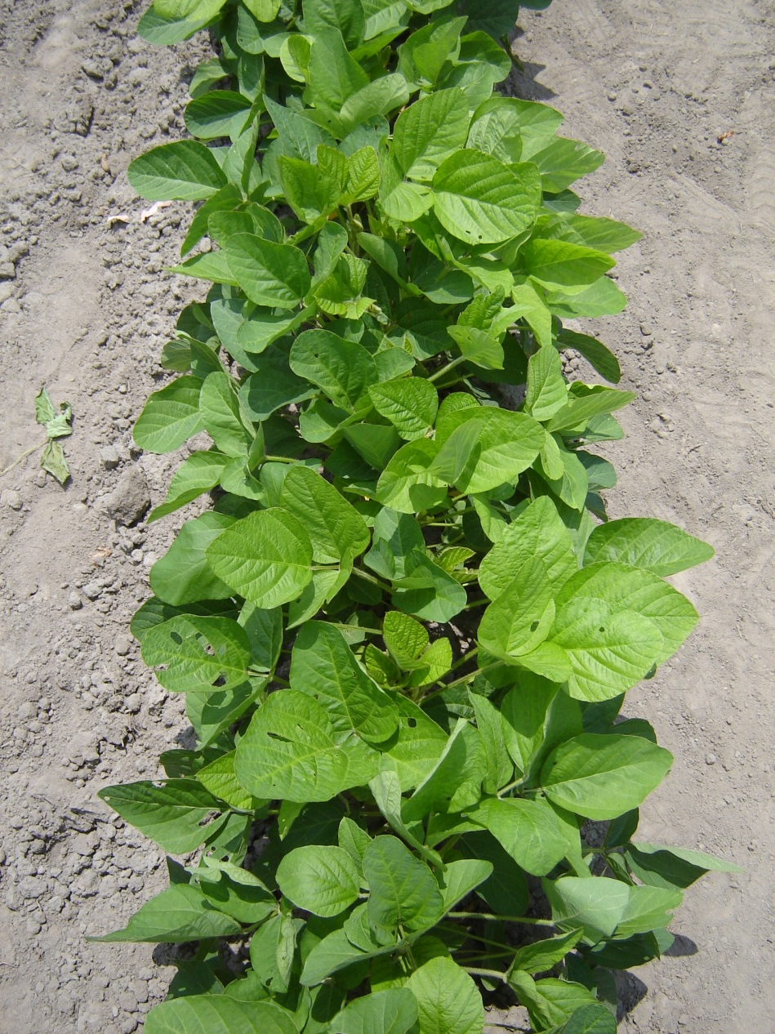
We will measure from 1st July to Sept (system already built and programmed)
At ~5 Hz:
Canopy temperature
and air temperature, relative humidity, solar radiation
Canopy height
At specific points in a field
An image of a canopy
Canopy red reflectance (NDVI)
Canopy stress index (PRI)
~160*3*20 = 9200 images
?500 Gb?

Slide 4
Our data problem
Phenotyping Cart
NO
Trigger Camera
Yes
Collect data from:
Camera
Collect data from:
Infra Red temperature
Ultrasonic Sensor (height)
Air temperature, solar radiation
Collect data from:
Infra Red
Ultrasonic Sensor
PIR,
NDVI,
Corresponding Image #
IMAGE POST PROCESSING
Stored in a simple data frame in the logger
Merge Outputs
Filter Data: remove soil, plot ends…

Slide 5

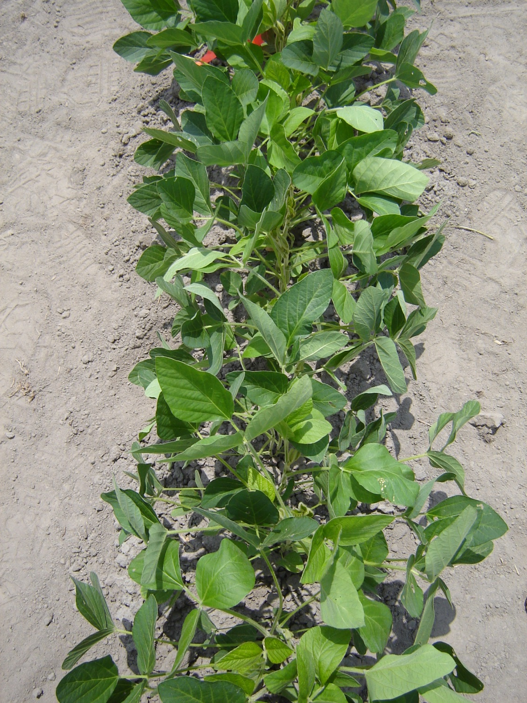
We want to develop a program to measure the plant responses in these two pictures

Slide 6
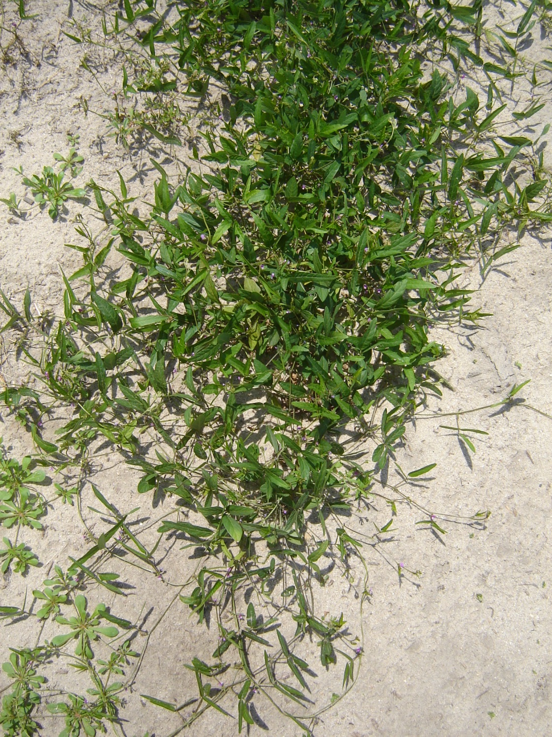
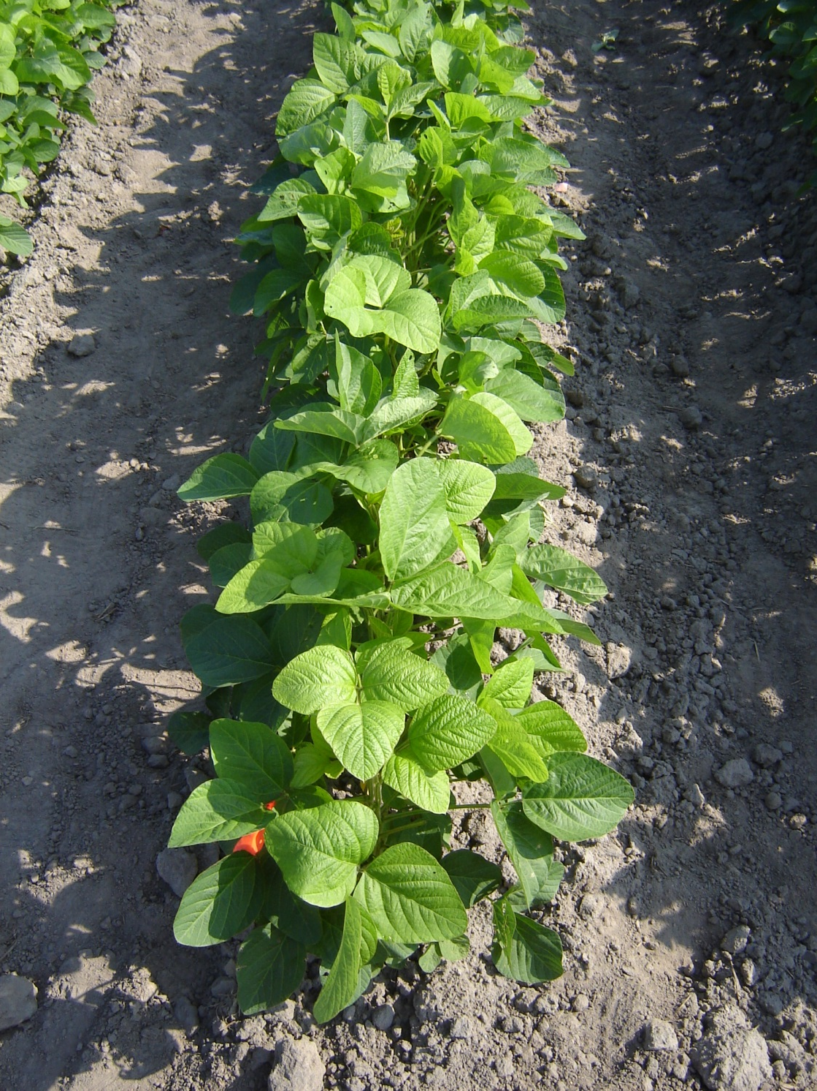
But there are issues, such as varying leaf size, large shadows etc.

Slide 7
Likely to need
Batch processing
Processing of CANON RAW or JPEG images (18Mpix)
Automated cropping out of cart structure
Adjustment for camera lens distortion
Automated or semi-automated thresholding to differentiate leaf from soil
Extraction of canopy – removal of soil
Segmentation into different leaves
Extraction of variables of interest

Slide 8
Image processing outputs
Easyish:
Green cover fraction: Percentage of image that is plant canopy
Shaded cover fraction: Percentage of canopy that is shaded versus full sunlight
Camera synching with datalogger (image # and plto #)

Slide 9
Image processing outputs
More challenging:
Percentage of canopy that is lower surface facing up (a sign of leaf orientation changes)
Leaf angle, indicating wilting and leaf paraheliotropism
Leaf projected size would appear to vary with wilting: output: histogram descriptors (mean, SD, skewness)
Automated spot recognition and measurement (we would place pink stickers of known area on leaves to assess before and after area/angle)

Slide 10
Options for better image analysis
Reference items:
We know the average canopy height…sensor
Scale bar at set height
RGB reference colors on side of image
Photograph of grid to adjust for lens distortion
A white plate with shadow bar to measure solar position.
Other things:
User interface: For each image the user could click 3 times on soil and three times on leaves and thus “teach” the program the thresholds.

Slide 11
What do we need?
Main goal:
an executable (etc) that will analyze the images,
output variables into a simple dataframe with reference number,
a simple GUI,
operational by end of summer.
Open source: many researchers are building similar devices, so a robust and adaptable platform would be useful.
Published: it would be great to publish this as an article or on a website…but not our main goal at this point

